Slide 1
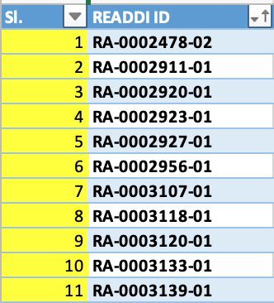
UNC-Brown|Anwar=DENV=p2=11_Göttelab_231030

Slide 2
DATA: Screening
DENV-2

Slide 3
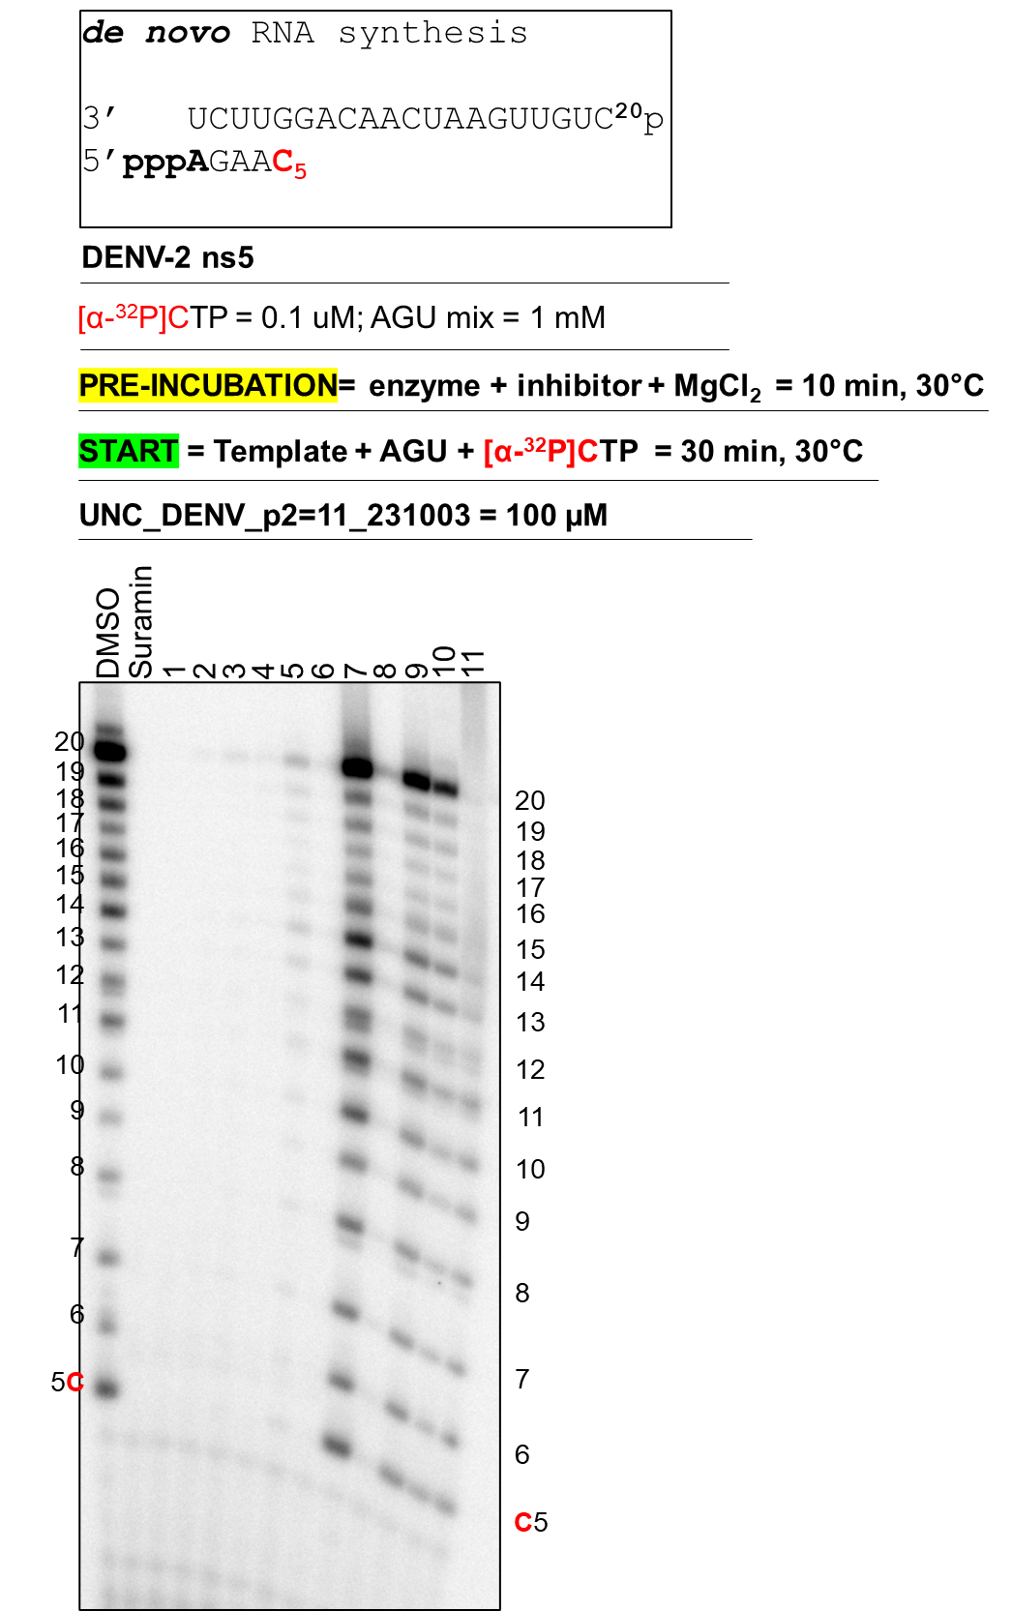
Data = Simon Walker

Slide 4
DATA: Screening
h-mtRNAP

Slide 5
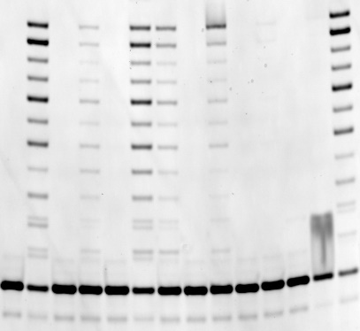
FAM-5’-UUUUGCCGCGCCA¹³
3’-GCGCGGTCAGTATTATTA²⁴-5’
h-mtRNAP
PRE-INCUBATION= enzyme + inhibitor + Mg^{5mM} = 20 min
START = primer||template^{50nM} +ACGU^{100uM} = 5 min @23°C
UNC_DENV_Set=2=11 = 100 uM
m
Ø
1
2
3
4
5
6
7
8
9
10
11
Ø
24
13

